Slide 1
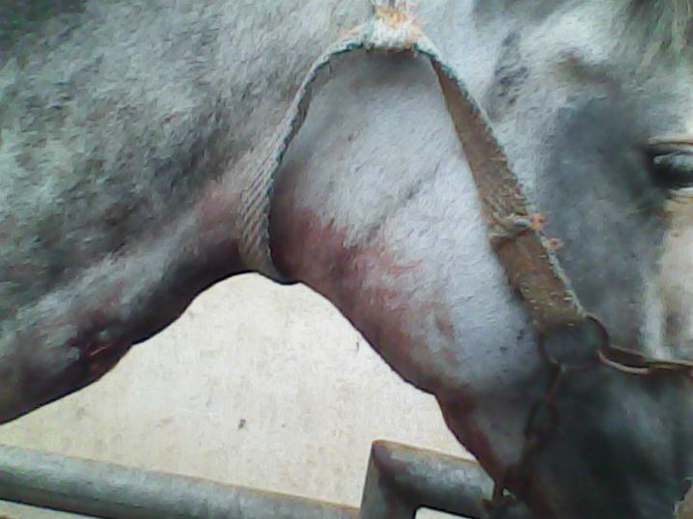
3-Phlebitis
vein is inflamed and felt as a thick cord ben
Types
A-Adhesive phlebitis
Vein is hard cord, The peri-venous edematous with presence of pain
Treatment
1-Rest to avoid extension of inf, or disintegration of thrombi
2-Providing for drainage of the wound and antiseptic
3-Application of counter irritant after the thrombus organized

Slide 2
B-Purulent phlebitis
Inflammatory symptoms more acute, and abscesses may be formed over the vein that may form fistula discharging hemorrhagic pus. Probing of the fistula may cause the probe to enter the vein
Treatment
1-Opening abscess after maturation and enlarging the fistulous orifice for removal of the necrotic tissue
2-Irrigation of the lesion by antiseptics
3-Otherwise, extirpation of the purulent vein can be performed

Slide 3
C-Hemorrhagic phlebitis
It is a complication of one of the fore-mentioned types of phlebitis due to disturbance of the clot of the vessels mechanically or as a result of infection. It is characterized by repeated hemorrhage.
Treatment
1-Plugging of the wound with antiseptic gauze to arrest bleeding
2-Ligation of the vein

Slide 4
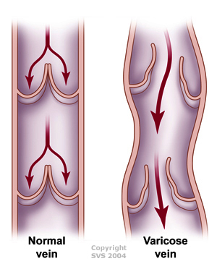
4-Varicose
1-Compression
2-Firing the skin
3-Obliteration
4-Ligation and excision

